Slide 1
Zoom Cloud Recording Link
Topic: CS2040C Wednesday Lectures
Start Time: Nov 10, 2021 01:51 AM
Meeting Recording:
https://nus-sg.zoom.us/rec/share/S-CWuGzqpRHOaRMvzEyGpLkEnwWdV7y4VUmcaszLnnR10P-cHCk7efdBYfGfnZfy.9xO1Ac2jktviHc6h
Access Passcode: q$mH^r0.

Slide 2
CS2040/C/S
Week 13a, MST (*NOT* optional from S1 AY 2021/22 onwards)

Slide 3
Admins
https://nus.kattis.com/sessions/atx79m line-up is settled
5 make-up (can go to 200 points), PE scores still 0 at the moment
20 OPT-IN remedial (can go only up to 124 points)
PS: Not all 20 here can improve by a lot actually, so if any of you eventually decided the efforts needed do not worth it and you want to study more for final paper(s) instead, please let me know, as I now have a few <= 40 pointers in PE who want to OPT-In and now eligible to do remedial
Level of difficulty will be “more-or-less” similar to the official PE
Zoom proctored, Wed, 17 Nov 2021, 10am-12nn, only by myself
Specific details to be communicated with these 25 pax nearing to 17 Nov
VA OQ (this Monday and Tuesday) went reasonably well
Highest: 20/20 (obviously, and lots of ties); Lowest: 7 ☹…; Average: 17.3/20
Chow-Yuan-Bin award winners: Ethan (B04), Qifan (B06), Yukihide (B07), Nigel+XinYu (joint fastest) (B08)
1 absentee (with MC :O) :S, 1 technical issue :(
Make-up on 17 Nov 12.10-12.30 noon, after make-up/remedial PE

Slide 4
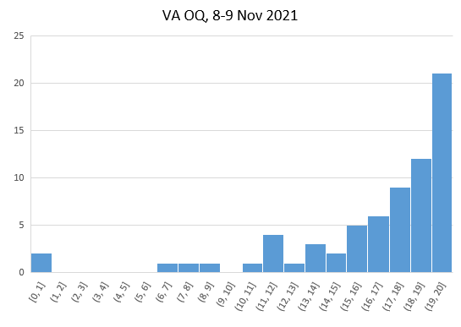
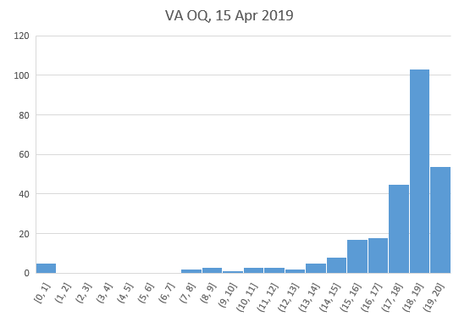
Histogram and Comparison with 2.5 years ago
S2 AY 2018/19 (don’t have the last year’s one)
S1 AY 2021/22
Got manual Q20

Slide 5
Not-Optional Summary Lecture: MST (1)
https://visualgo.net/en/mst?slide=1 to end, both Prim’s and Kruskal’s
A grand tour of many parts of CS2040C module (details in Slide Notes)
We just use the e-slides, not really a flipped class for today
I have decided to ask *simple* question(s) about MST in final
“You understand this lecture → you should score” type of questions…
So that this 2 hours are not “wasted” / “freely skipped” by so many senior students like in the past AYs
Notes:
Grand tour: C++17 (live code two versions of MST algorithms), Algorithm Analysis (Analyze that Prim’s and Kruskal’s are both O(E log V), especially the technique of transforming O(log E) into O(log V^2) = O(log V)), link sorting for edge list sorting of Kruskal’s, link Prim’s Priority Queue to Binary Heap and/or Balanced BST, link UFDS for Kruskal’s, link Graph DS (Edge List for Kruskal’s or Adjacency List for Prim’s, kinda List ADT but not a standard list), can say Prim’s visited Boolean flag as “DAT” (Table ADT too)…, link DFS/BFS/Dijkstra’s (SSSP) Spanning Trees of various input connected weighted graphs.
Cannot be forced-linked: Stack/Queue/Deque (probably irrelevant for MST)… any idea how to squeeze this concept inside MST summary lecture?

Slide 6
Not-Optional Summary Lecture: MST (2)
Notice the similarities of Kruskal’s and what you have learned before:
The usage of 2 DSes: UFDS DS (to keep track of connected components/helpful in detecting potential cyclic situation efficiently) and Edge List graph DS (for sorting the edges by non-decreasing weights)
The fact that Kruskal’s grows a spanning forest of connected components (mini trees in each CC), until the final step (the (|V|-1)-th taken edge) when it merges two CCs (two subtrees) into one MST
The fact that Kruskal’s is as greedy as Dijkstra’s
The differences: Dijkstra’s greedily selects the next vertex with the smallest distance estimation from source, Kruskal’s greedily select the next edge with the smallest weight that is not going to cause a cycle

Slide 7
Not-Optional Summary Lecture: MST (3)
Notice the similarities of Prim’s and what you have learned before:
The usage of 3 DSes: Priority Queue ADT, Adjacency List graph DS, visited array (I can say that this visited array is a Direct Addressing Table ☺)
The fact that Prim’s grows a spanning tree from a selected source vertex s, similar to DFS, BFS, and SSSP (Dijkstra’s, either version)
The fact that Prim’s is as greedy as Dijkstra’s
The differences: Dijkstra’s greedily select the next vertex with the smallest distance estimation from source, Prim’s greedily select the next edge with the smallest weight that is not going to cause a cycle (same as Kruskal’s)

Slide 8
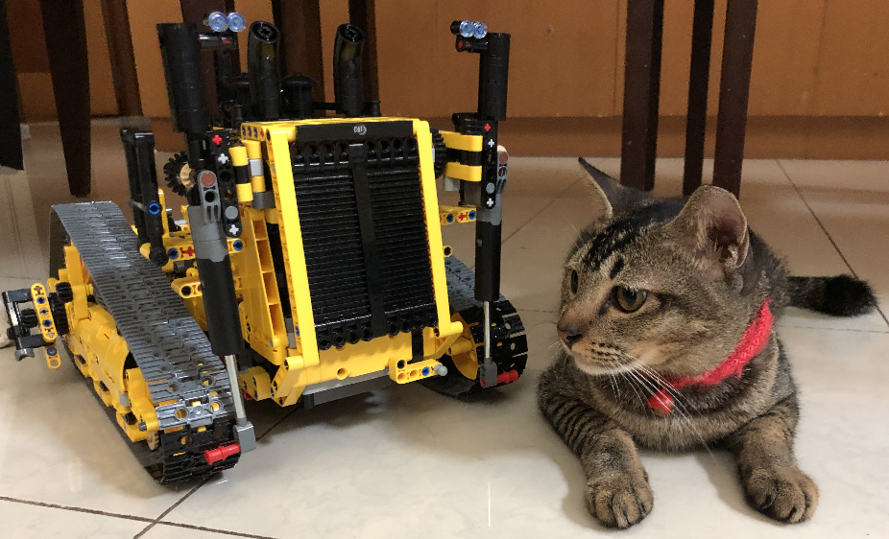
Implementation Example
See live code on Kattis – cats and the comments there later
Two MST algorithms in one code

Slide 9
Last Lecture Tomorrow
Important Topics:
Undoing bad SE practices :O
Advertisements: future relevant modules…, TA jobs :O
Final Paper Hints :O…
Final class we-fie (if you agree to be featured – turn on your webcams)

